Slide 1
Understanding Ionization Variance from Sub-keV Nuclear Recoil Events in Direct Detection Dark Matter Experiments
Mitchell Matheny
University of Colorado Denver

Slide 2
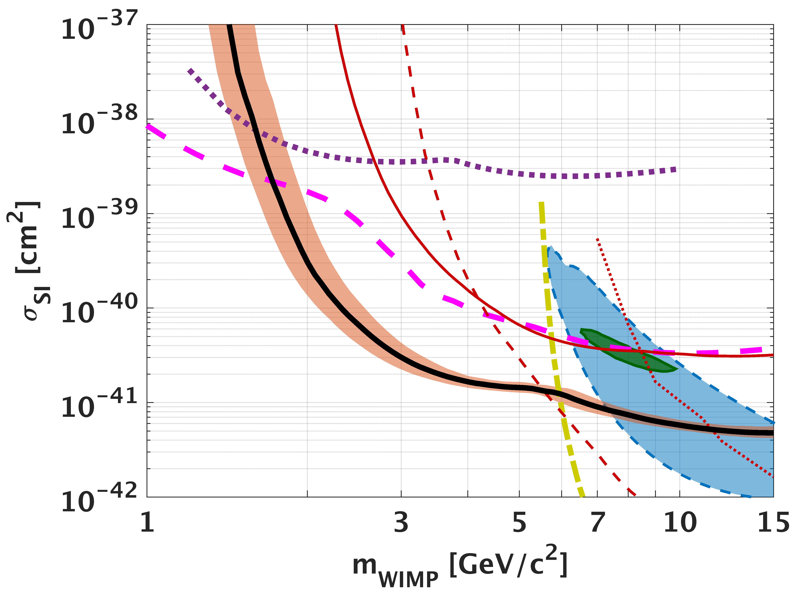
Dark Matter
Dark matter has been theorized to be Weakly Interact Massive Particles(WIMPs) with masses on the order of a GeV/c² to a few TeV/c^{2.}
In the post Minimal Supersymmetric Standard Model era, we are completely in the dark on the dark matter mass.
Dark matter could still be "WIMP" like in that it could interact with nuclei - but < 70 GeV masses are increasingly of interest.
Currently, detectors that count electron-hole pairs have good sensitivity to low-mass WIMPs
CDMSlite
SuperCDMS
CRESST
LUX
DOI: 10.1103/PhysRevLett.116.071301
Notes:
Going to Focus on WIMPS only.
Dark Matter experiments such as CDMS and CREST are trying to push down to lower thresholds.
The detects that are trying to do this are solid state detectors with some sort of voltage applied to them. They are essentially electron-hole pair counters.

Slide 3
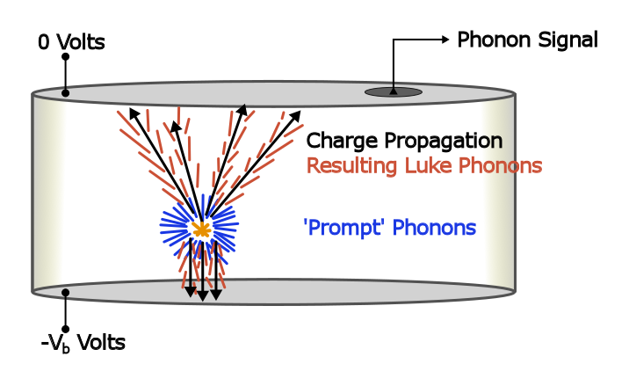


Charge Creation in Solids
When dark matter hits a nucleous, charge is liberated.
Current generation of low threshold detectors count number of charge carriers produced.
Notes:
A WIMP comes in a hits the nuclei, initial phonons are produced and charge is liberated in some ratio. Current generation of lowest threshold detectors only count the number of produced electron hole pairs. We do not have a good nuclear recoil calibration standard. Therefore to extract the nuclear recoil energy we have to know the ratio of recoil energy that goes into the electronic system.
Variation in energy given to the electronic system exists because a single E_r can create a spectrum of a possible number of electron hole pairs
Solid State detector with a voltage across it. For the purpose of this talk.

Slide 4
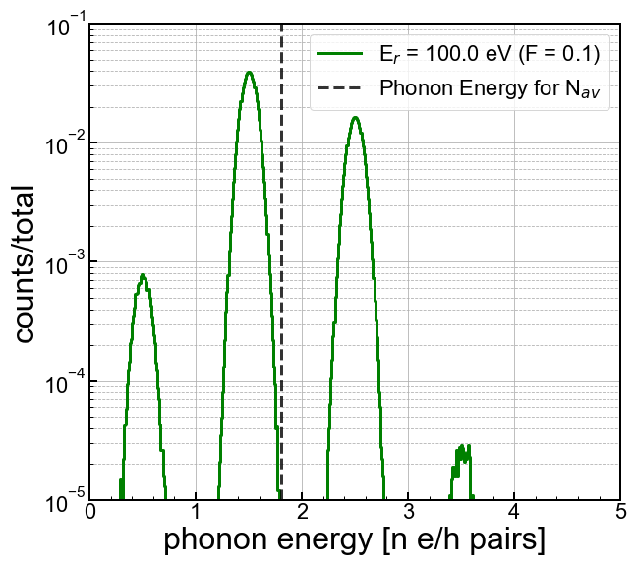
HVeV Detector and a Single E_{r}
A detector developed at Stanford has developed a detector that can support 160V bias and a 14eV resolution.
DOI 10.1063/1.5010699
Given this high sensitivity, the spectrum for a single E_{r} looks different than you might expect - this is due to randomness in electron-hole pair production
Each peak represents a different number of electron hole pairs produced.
Notes:
Citation for HVeV

Slide 5


Ionization Yield
Electron Recoils
The ionization yield Y converts from recoil energy Er to the average number of electron-hole pairs produced <Neh>
The mean number of electron hole pairs produced varies greatly for electron recoils and nuclear recoils.
Measurements of charge and phonon would mean great discrimination between electron and nuclear recoils (far better than PSD and liquid scintillators)
Nuclear Recoils
This makes the energy scale for nuclear
recoils nonlinear.
Notes:
A WIMP comes in a hits the nuclei, initial phonons are produced and charge is liberated in some ratio. Current generation of lowest threshold detectors only count the number of produced electron hole pairs. We do not have a good nuclear recoil calibration standard. Therefore to extract the nuclear recoil energy we have to know the ratio of recoil energy that goes into the electronic system.
Variation in energy given to the electronic system exists because a single E_r can create a spectrum of a possible number of electron hole pairs

Slide 6
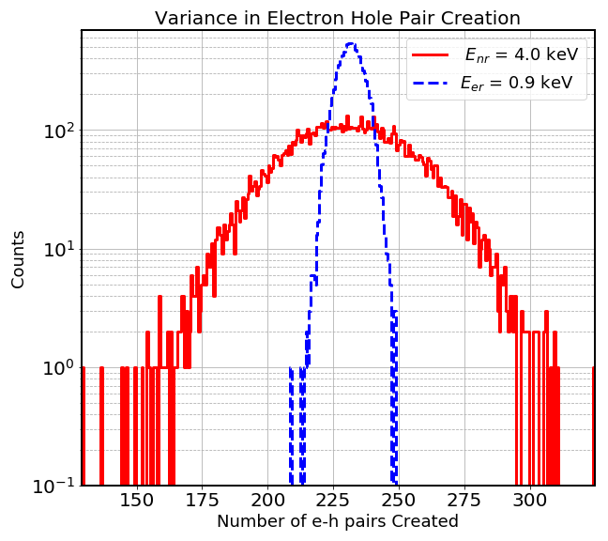
Variation in Electron Hole Pair Creation
A measurement has been made in silicon for this phenomena.
DOI. 10.1103/PhysRevA.45.2104
The number of electron hole pairs produced varies for a single nuclear recoil energy.
It also varies for electron recoils, but much less.
The variance in eh pairs produced by a nuclear recoil significantly impacts any nuclear-recoil signal spectrum
Notes:
There is a variant number of electron hole pairs exists for a given Er for both electron recoils and nuclear recoils.

Slide 7
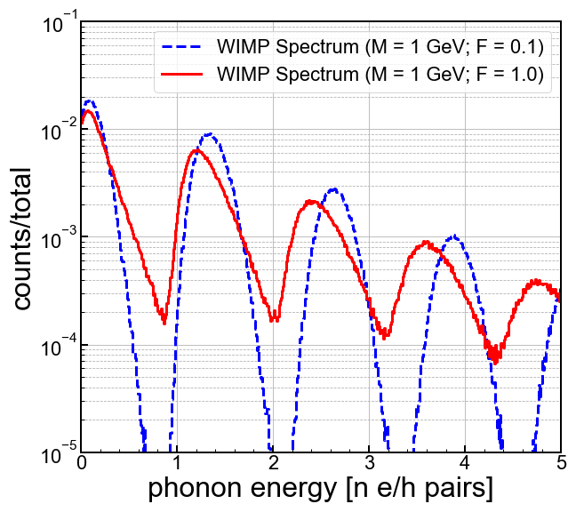
HVeV Detector and a Dark Matter Spectrum
For detectors that count eh pairs, the variance in Neh can dramatically affect low-mass dark matter searches
Different variation in Neh changes the interpretation of observed experimental spectra.
Notes:
Will talk more about it. Less bullet points.

Slide 8
HVeV Detector and a Dark Matter Spectrum
Event at 3.5 e/h pairs
F = 1
F = 0.1
Notes:
Will talk more about it. Less bullet points.

Slide 9
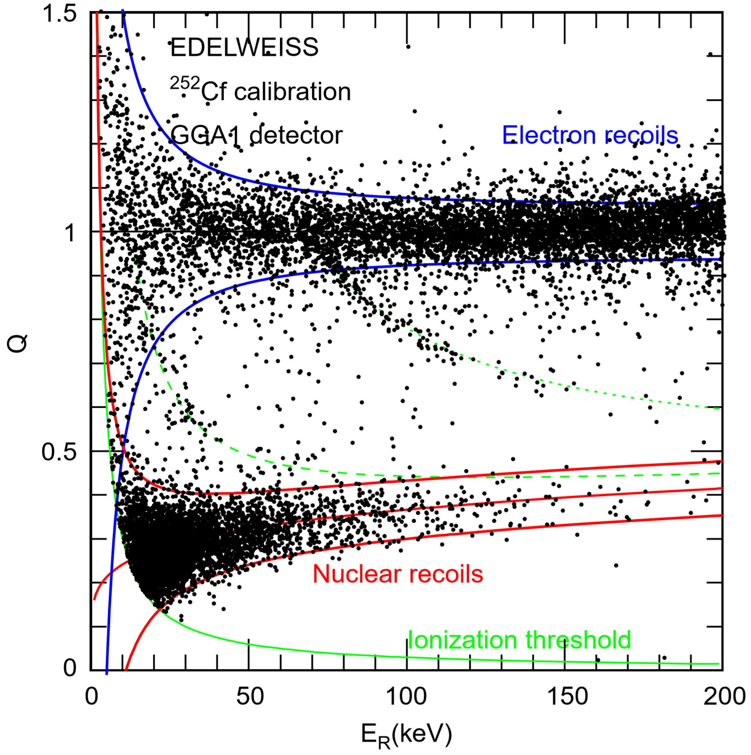
Quantifying Ionization Variance
Ability to directly to measure charge and phonons separately. Allowing for a direct measurement of the ionization efficiency.
Should be able to extract the width of the nuclear recoil band.
Allows quantify the variation in electron hole pair production.
DOI 10.1016/j.nima.2004.04.218
Notes:
They can measure charge and phonons separately, this gives them a direct measure of the yield.

Slide 10
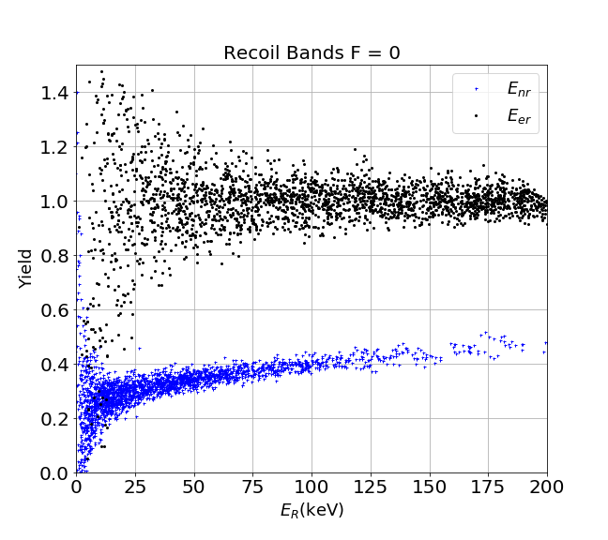
Quantifying Ionization Variance
SIMULATED
Notes:
They can measure charge and phonons separately, this gives them a direct measure of the yield.

Slide 11
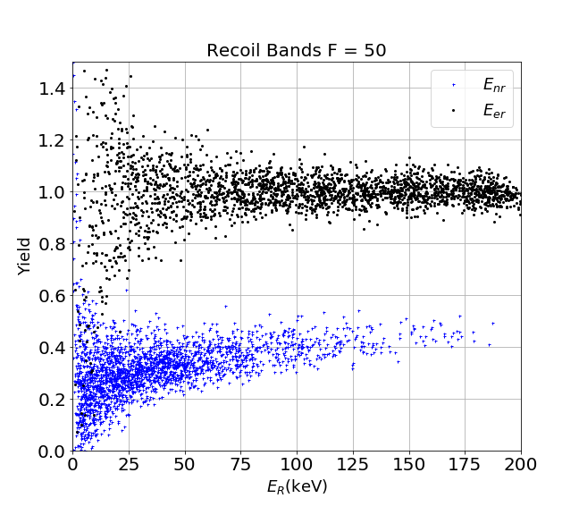
Quantifying Ionization Variance
SIMULATED
Notes:
They can measure charge and phonons separately, this gives them a direct measure of the yield.

Slide 12
Summary
Our work is searching literature for constraints for the variance in electron hole pair creation at different energies.
Edelweiss and CDMS give us good information for high recoils energies.
We are going to need to make our own measurements for energies relevant for low mass WIMP searches (@ and below 1 Gev)
Understanding the distribution of the number of electron hole pairs created is crucial to understand these measurements.
Notes:
Bands from data -> simulated bands. Side by side.

